Slide 1


Avatars scenario library
Western architecture
DECEMBER 2021

Slide 2





































Simple buildings with foliage

Slide 3




















Housing and hospitals

Slide 4



















Various buildings

Slide 5



























Various buildings

Slide 6


Two building clusters

Slide 7









Example background scene

Slide 8



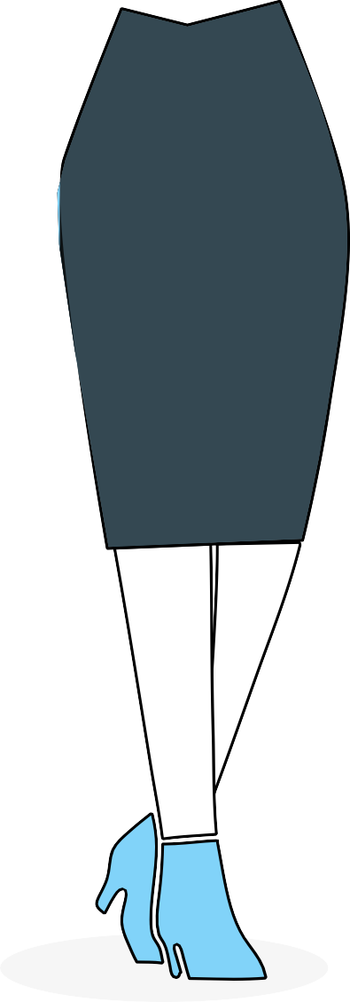





Example background scene

Slide 9


Example background scene

Slide 10

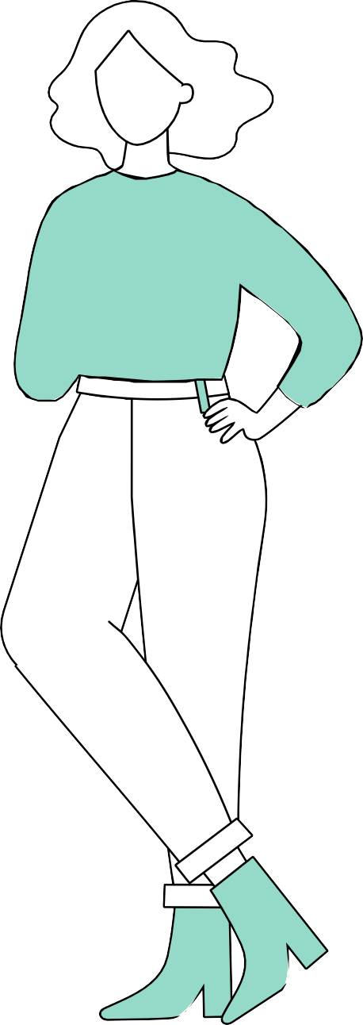
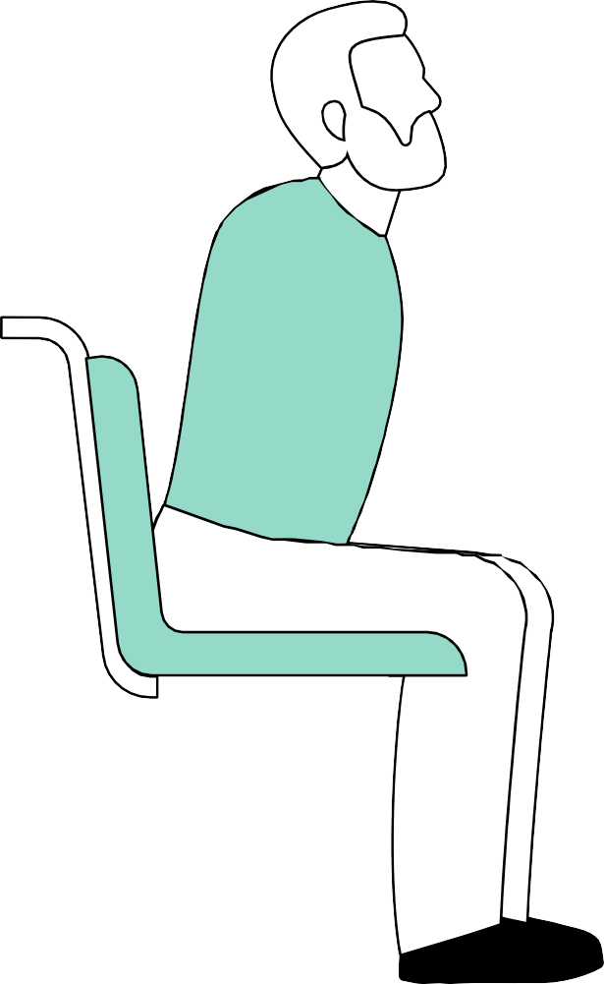


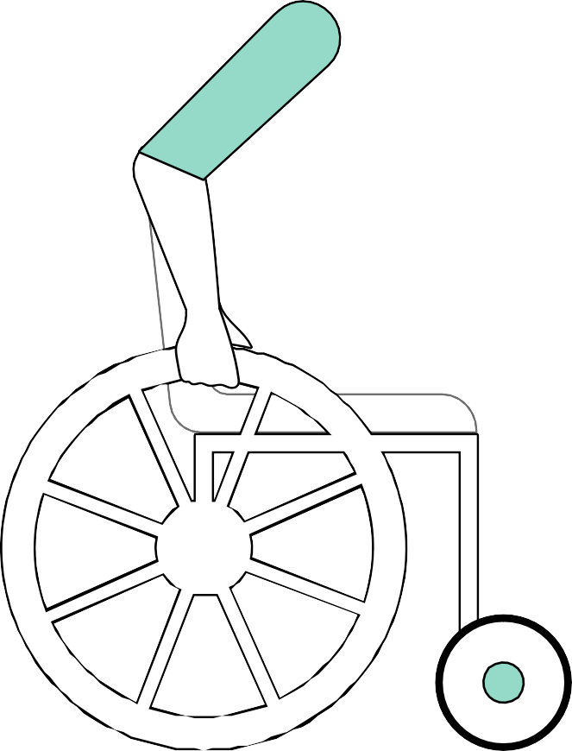

Example background scene

Slide 11


Two example background scenes

Slide 12
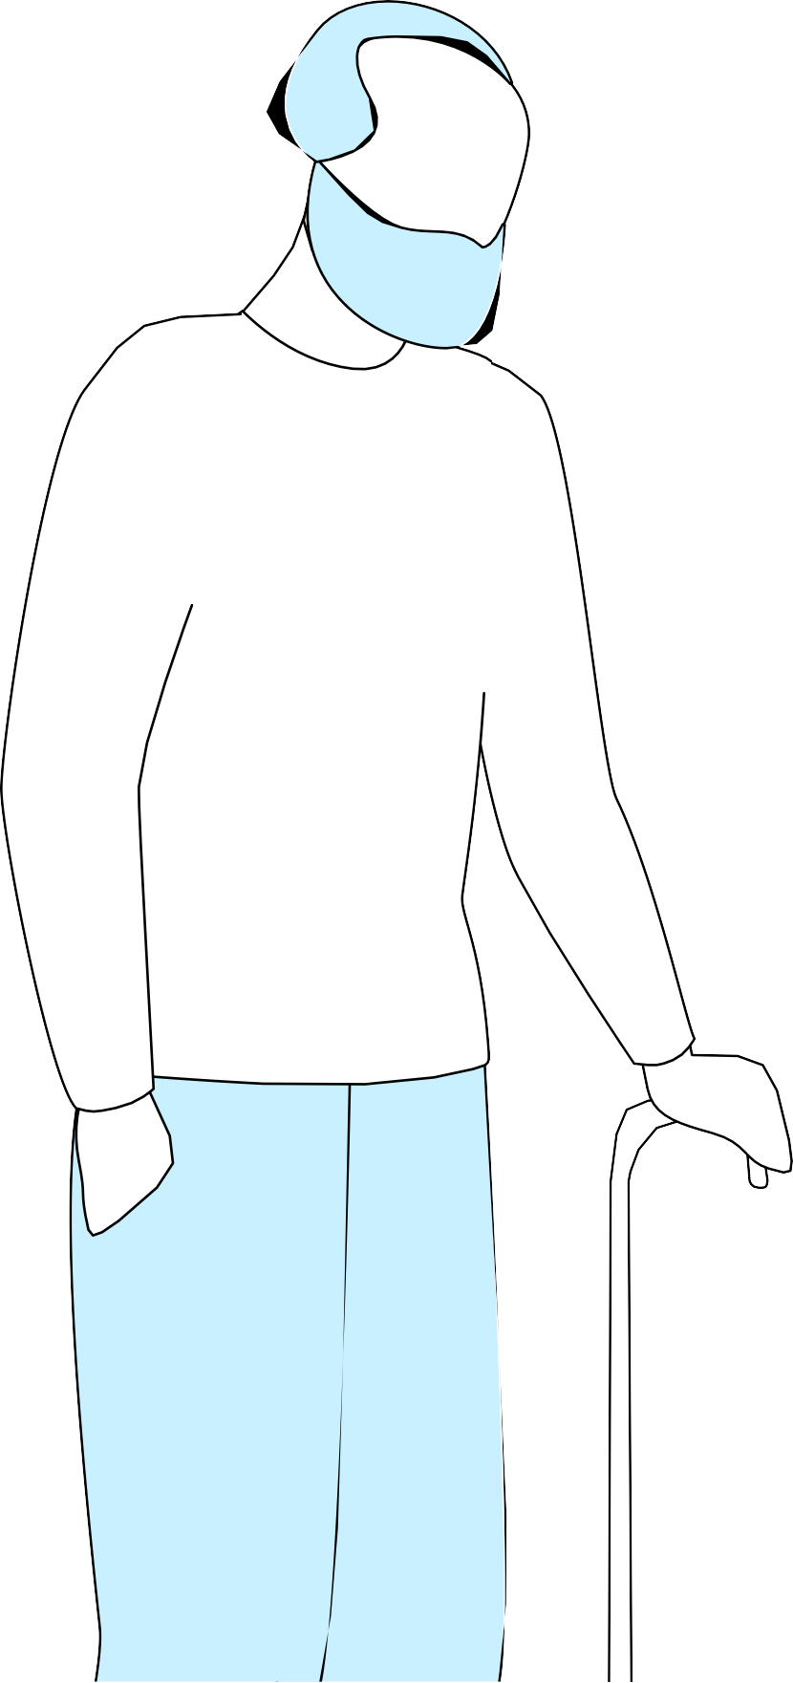
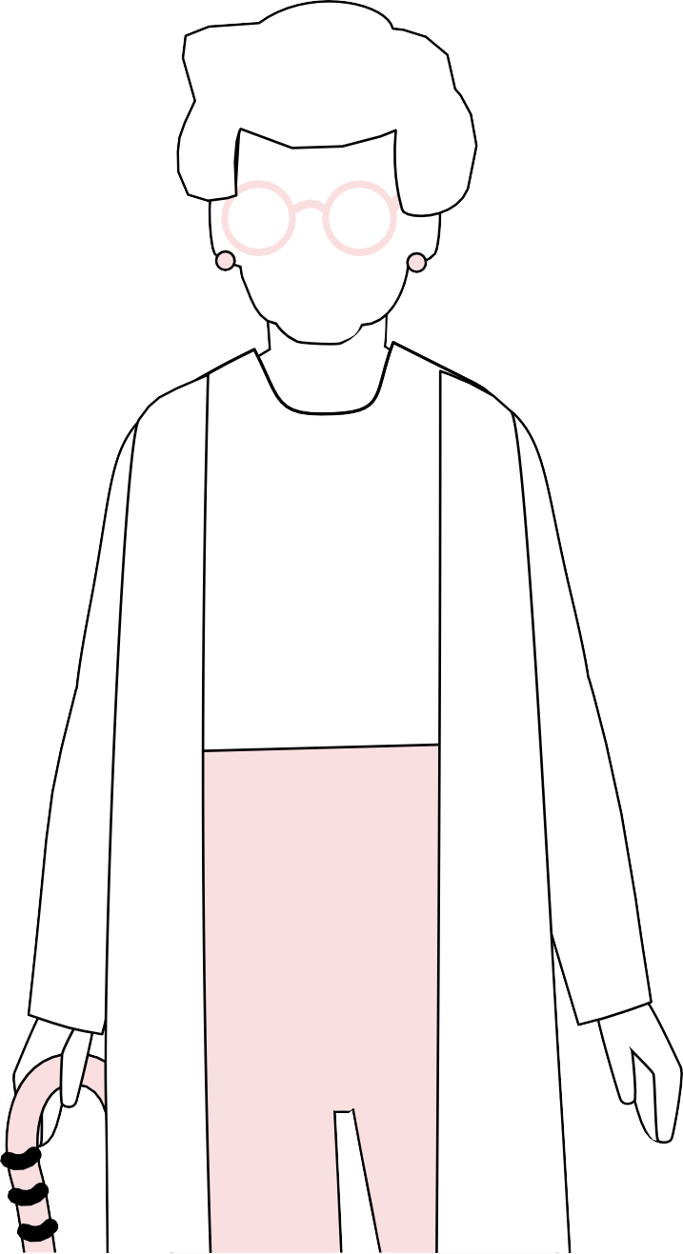

Example background scene

Slide 13
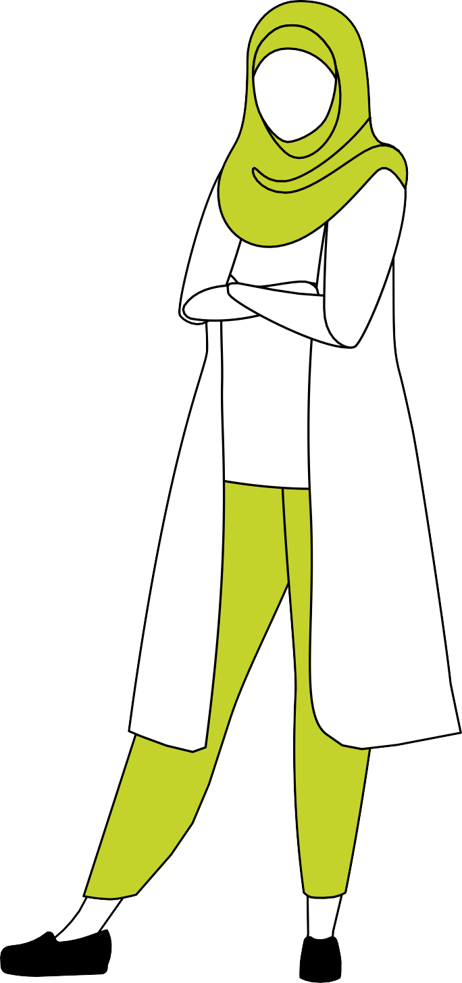


Example background scene

Slide 14



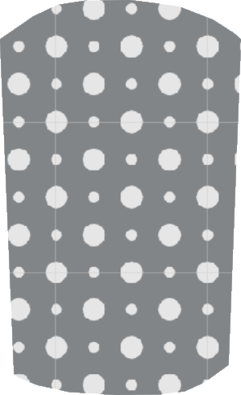











Example background scene

Slide 15
Example background scene

Slide 16

Deloitte refers to one or more of Deloitte Touche Tohmatsu Limited
(collectively, the “Deloitte organization”). DTTL (also referred to as “Deloitte separate and independent entities, which cannot obligate or bind each related entity is liable only for its own acts and omissions, and not those
of each other. DTTL does not provide services to clients. Please see www. deloitte.com/about to learn more.
© 2021. For information, contact Deloitte Touche Tohmatsu Limited.

